Slide 1
Introduction to MAD-X
N. Fuster Martínez, IFIC (CSIC-UV)
Material based on Guido Sterbini, Öznur Mete and Bruce Yee courses
22nd of January 2024

Slide 2

DISCLAIMER
GOAL
The goal of this course and workshop is to work on the understanding of transverse beam dynamics concepts in magnetic lattices by taking a hands-on approach (using the software MAD-X), complementing the Transverse Beam Dynamics course
This material is intended to be a very brief introduction to MAD-X: a large part of the code capabilities are not discussed in detail or are not discussed at all!
If you want to deepen into the subject, you can find a lot of material in:
The official MAD-X web site: http://mad.web.cern.ch/mad/
An Introduction to Beam Physics: https://library.oapen.org/bitstream/handle/20.500.12657/50888/9781420011821.pdf?sequence=10

Slide 3
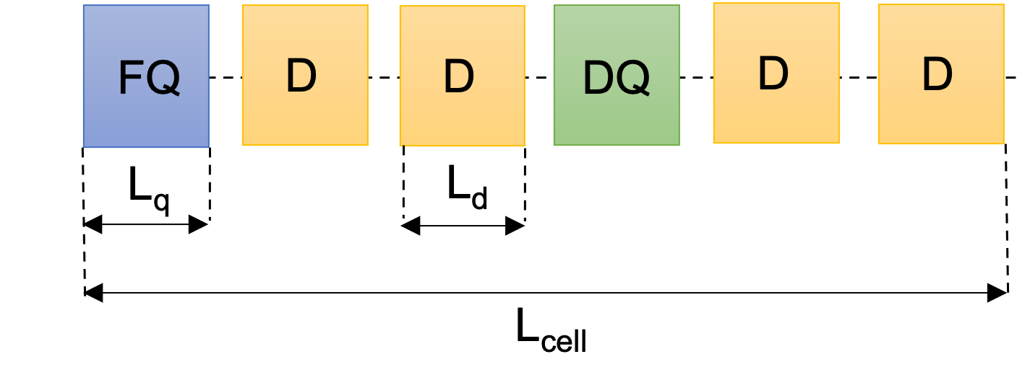
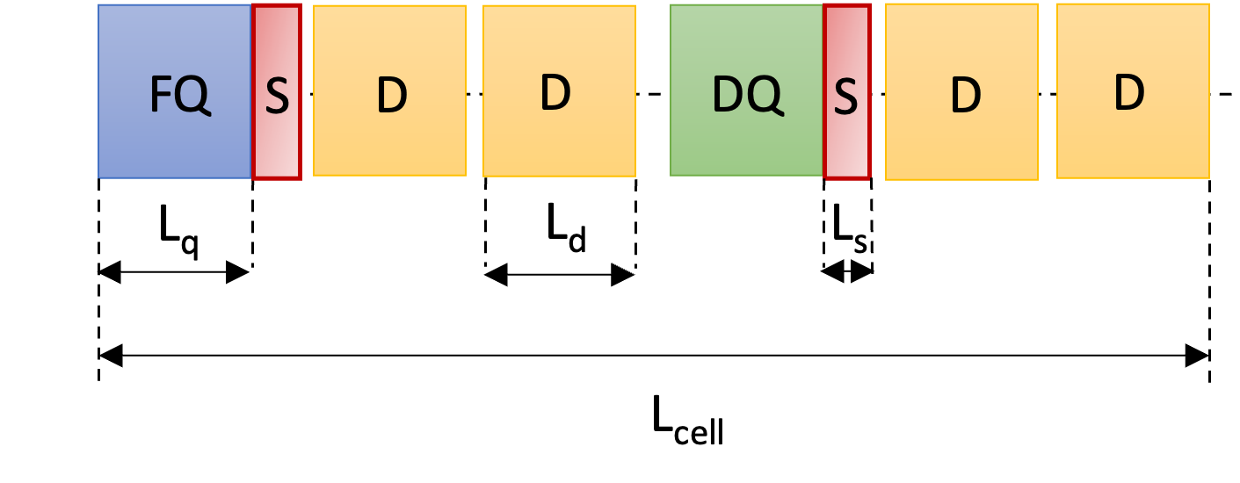
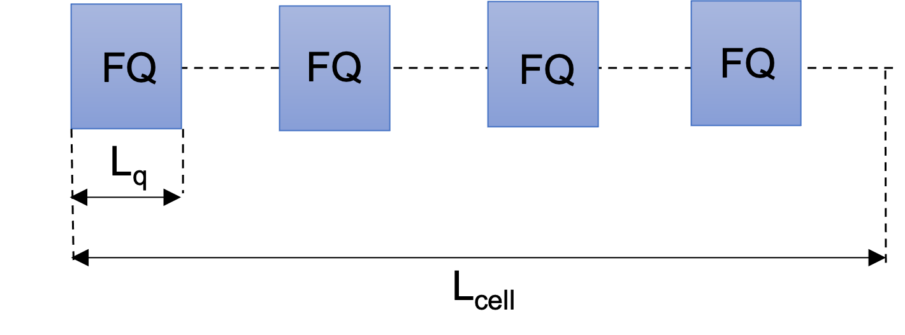
MAD-X workshop overview
50 minutes lecture (now!)
First “hands-on” session (3h) (22nd afternoon)
Tutorial 1: My first accelerator, a FODO cell
Tutorial 2: My first matching
30 minutes break
Tutorial 3: Building a circular machine
Second “hands-on” session (3h) (23rd afternoon)
Tutorial 4: Natural chromaticity
Tutorial 5: Chromaticity correction and non-linearities
30 minutes break
Tutorial 6: Building a transfer line
Tutors: Nuria Fuster-Martínez, Guido Sterbini, Davide Gamba, Javier Olivares

Slide 4
Outline
Introduction. Description of basic concepts
MAD-X language. Syntax, variables
MAD-X commands. Magnets, sequence and beam definition
Advanced MAD-X commands. Twiss, matching and tracking
Example case. A FODO cell
How to run MAD-X. Interactive mode, batch mode and python interface

Slide 5
Introduction
General purpose of a beam optics code.
What is MAD-X?
Do we use MAD-X for everything? No!
Why MAD-X?
How does it work?
Source code: the basic components.

Slide 6
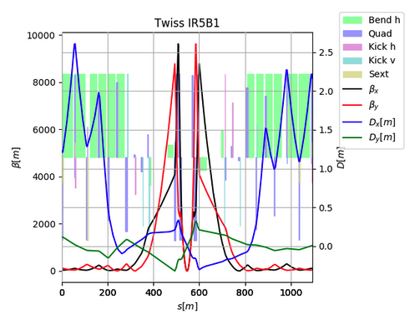
General purpose beam optics code
Enables to design accelerators meeting specific research and application goals and to predict the behaviour of particle beams in those accelerators with a high degree of accuracy
In such codes, the charge particle’s equation of motion is solved under the effect of external EM fields from different accelerator components
They are used to:
Define the lattice of circular or linear accelerators
Compute linear optics functions and beam properties
Design a lattice for getting the desired properties (matching)
Simulate accelerator imperfections and design correction schemes
Simulate beam dynamics: study single-particle motion
LHC IP5

Slide 7
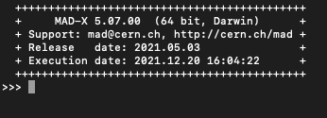

What is MAD-X?
MAD-X (Methodical accelerator Design)
A general-purpose beam optics software
Distributed for free by CERN and used since more than 25 years for machine design and simulations (PS, SPS, LHC, linacs…)
MAD-X is written in C/C++/Fortran (source code available under the CERN copyright)

Slide 8

Do we use MAD-X for everything? No!
We use MAD-X to:
Perform basic layout design and optimization
Perform basic single-particle tracking and sensitivity analysis of linear and circular accelerators
We don’t use MAD-X for:
Multi-particle and multi-bunch simulations
Simulations requiring non static machines, i.e., beam changes its own environment (space charge, instabilities, beam-beam effects)
Often the programs used for these kind of studies use inputs from MAD-X

Slide 9
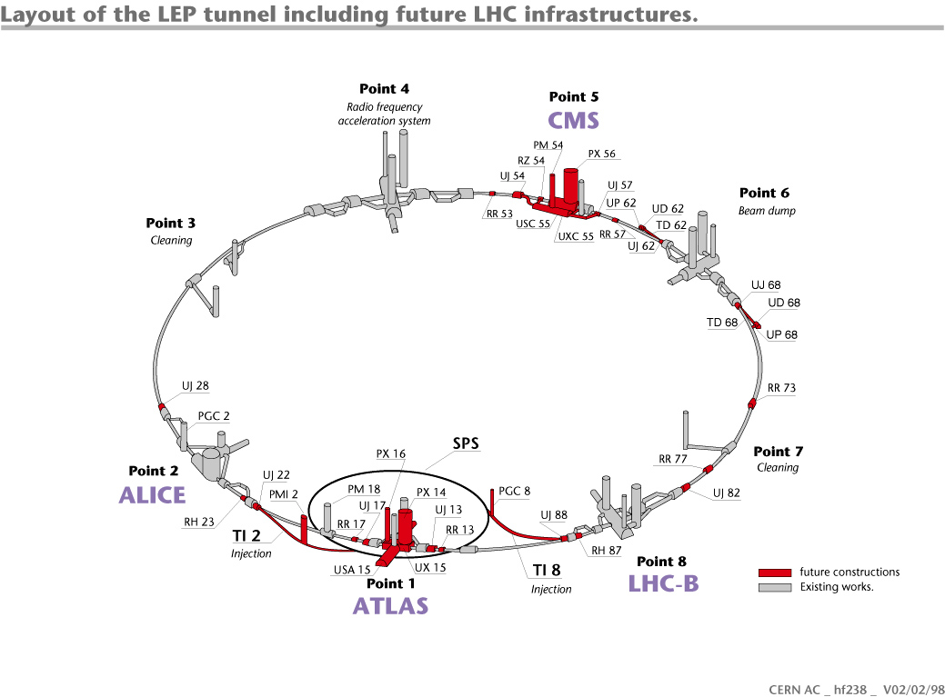
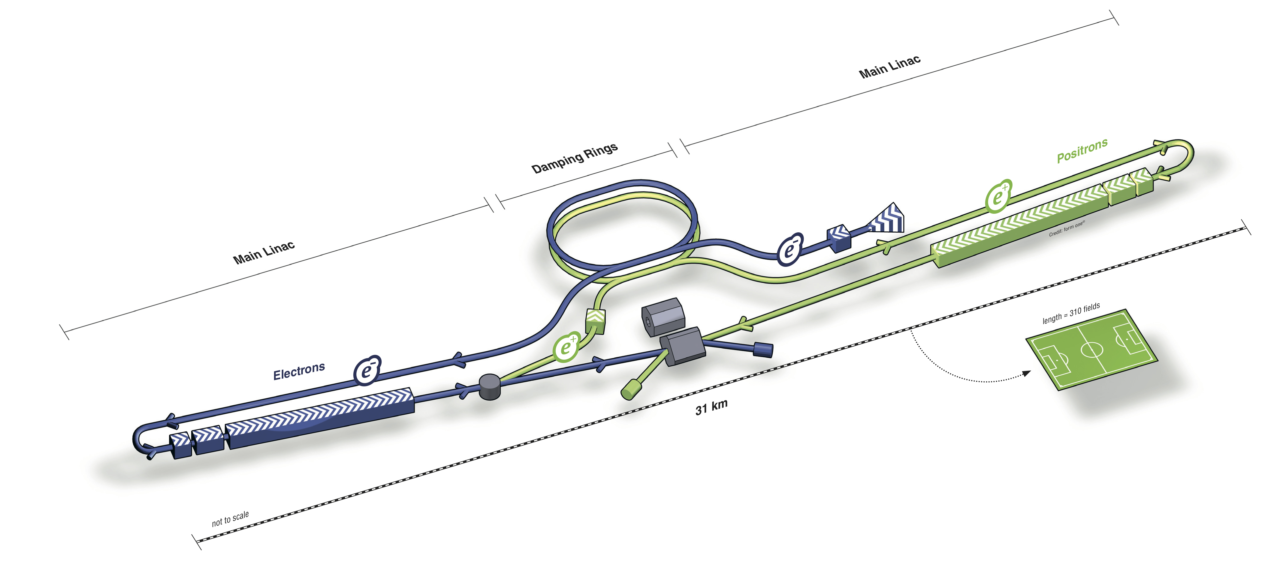
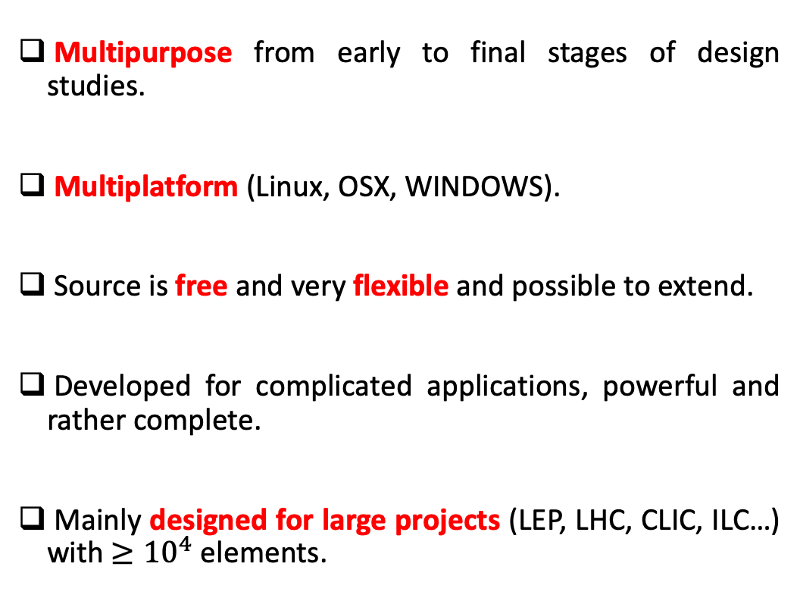
Why MAD-X?
Multipurpose from early to final stages of design studies.
Multiplatform (Linux, OSX, WINDOWS).
Source is free and very flexible and possible to extend.
Developed for complicated applications, powerful and rather complete.
Mainly designed for large projects (LEP, LHC, CLIC, ILC…) with $≥{10}^{4}$ elements.

Slide 10
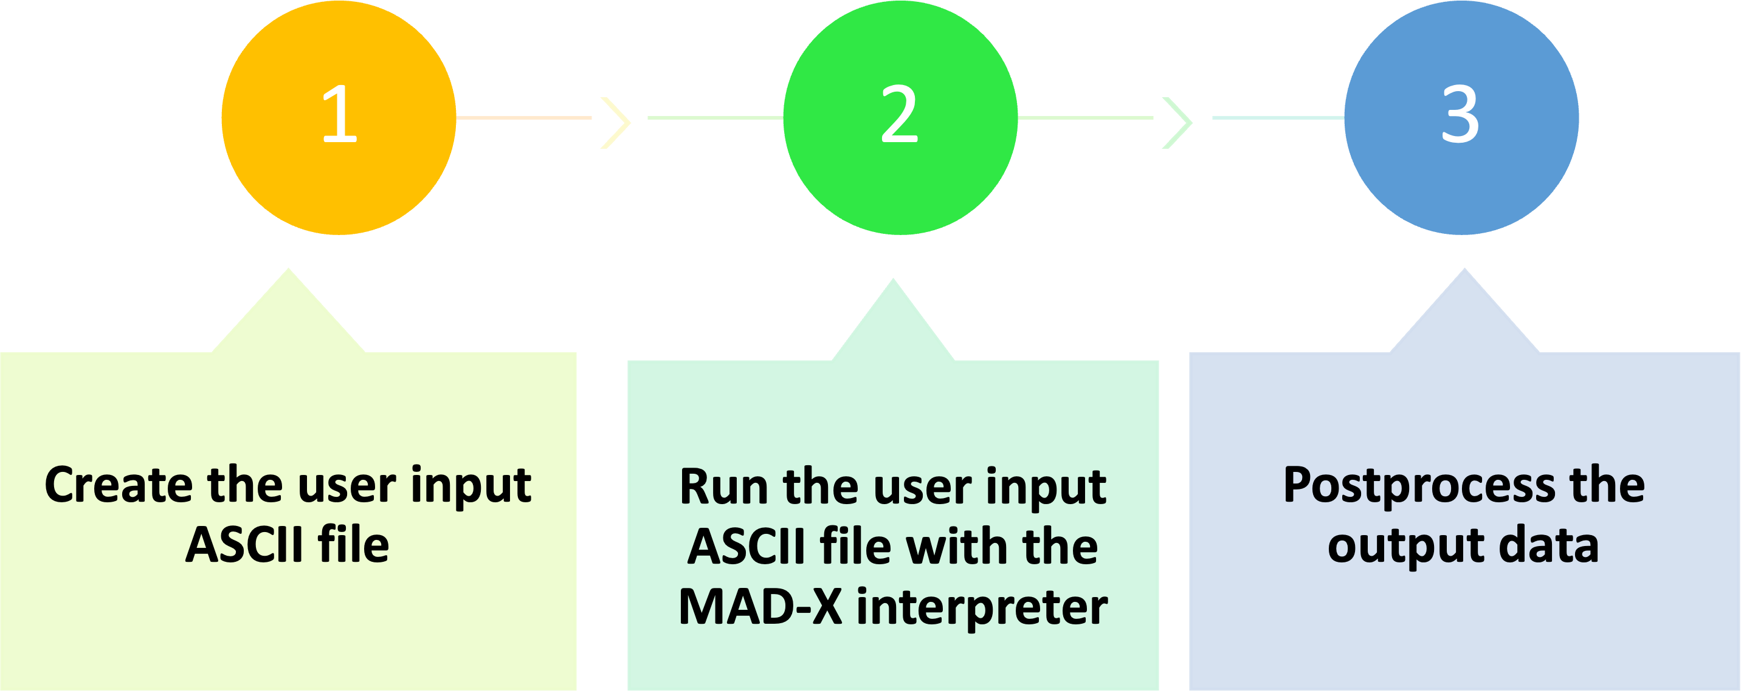
How does it work?
MAD-X is an interpreter
It accepts and executes statements.
Statements can be actions (optics…) or assignments (machine properties…)
What is the source code? Via text
It can be used in an interactive way (input from command line) or in batch (input from a file)
MAD-X has its own scripting language, which is used to interface with the software.
Strong resemblance to “C” language (but NO need for declaration and NOT case sensitive)
Many features of programming language (loops, if, macros…)

Slide 11
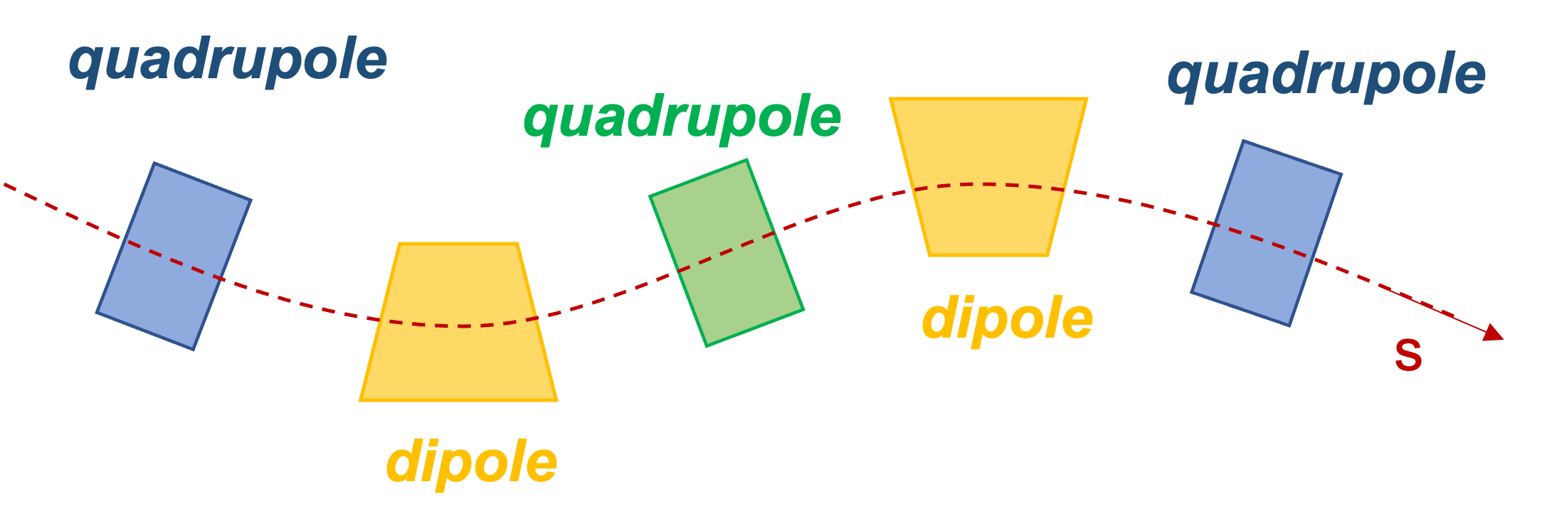
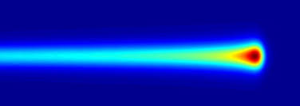
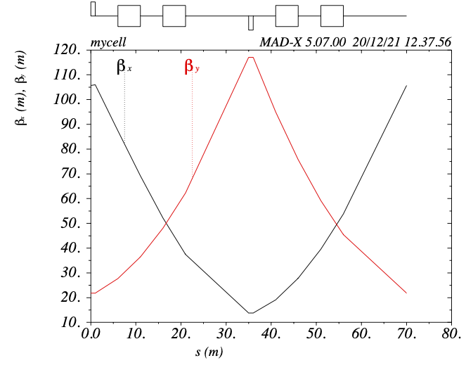
Source code: the basic components
Description of the machine
Accelerator elements, physical attributes and location….
What is the machine in question?
Description of the beam
Type of particle, energy…
What will be running in the machine?
Actions
Optics calculation, matching, tracking….
What do you want to study about the machine?

Slide 12
MAD-X language
Language features
Conventions
Optic variables

Slide 13

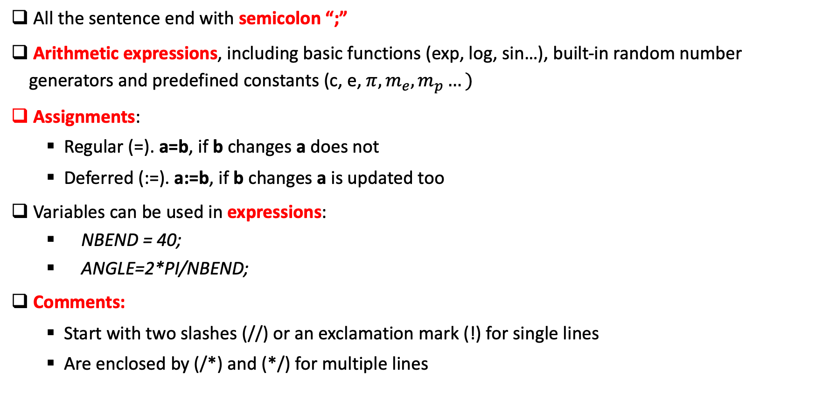
Language features
All the sentence end with semicolon “;”
Arithmetic expressions, including basic functions (exp, log, sin…), built-in random number generators and predefined constants (c, e, $π, m_{e},m_{p}…)$
Assignments:
Regular (=). a=b, if b changes a does not
Deferred (:=). a:=b, if b changes a is updated too
Variables can be used in expressions:
NBEND = 40;
ANGLE=2*PI/NBEND;
Comments:
Start with two slashes (//) or an exclamation mark (!) for single lines
Are enclosed by (/*) and (*/) for multiple lines
Deferred expressions Important for the variables you may need to change along the code (e.g. matching parameters…)!

Slide 14
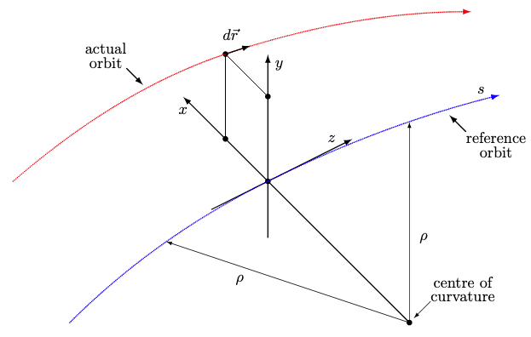
Conventions
Units: all parameters are in terms of SI units, except the energy, momentum and mass expressed in GeV, GeV/c and GeV/c²
Horizontal plane is assumed to be the bending plane
Elements are placed along the reference orbit moving along s
x = y = 0 in a curvilinear system
The reference orbit is the path of a charge particle having the central momentum of the accelerator though idealised and perfectly aligned magnets
The closed orbit is described with respect to the reference orbit, using the local reference system (x, y, s) and includes all nonlinear effects

Slide 15
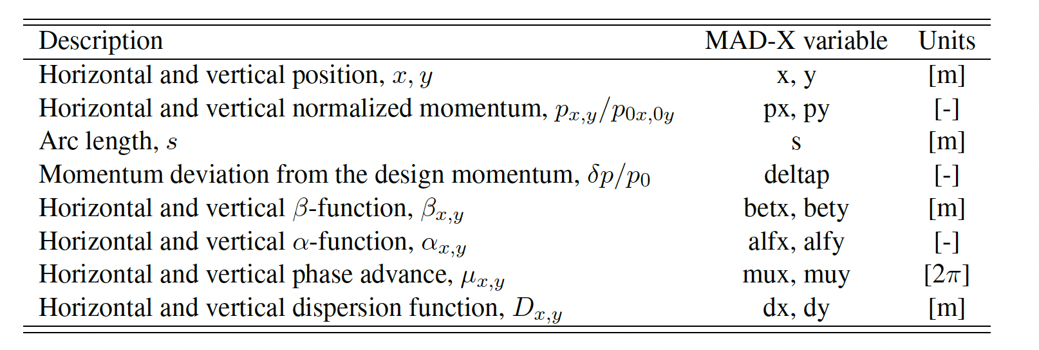
Main particle’s coordinates and optics functions

Slide 16
MAD-X commands
Generic pattern for MAD-X commands
Definition of lattice elements
The strength of the magnets.
The lattice sequence
Basic MAD-X commands

Slide 17
Generic pattern for MAD-X commands
label: keyword, {attributes};
Name given by the USER to the stored command.
If a label is given, MAD-X keeps this command in memory and can be used as
‘EXEC label;’
Action desired.
Protected by MAD-X, cannot be used as label
Defined data to the command.
String, logical, integer, expression or range selection. The items enclosed in {} can be omitted

Slide 18
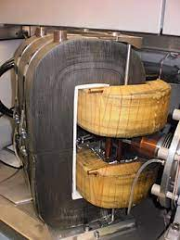
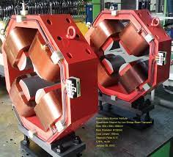
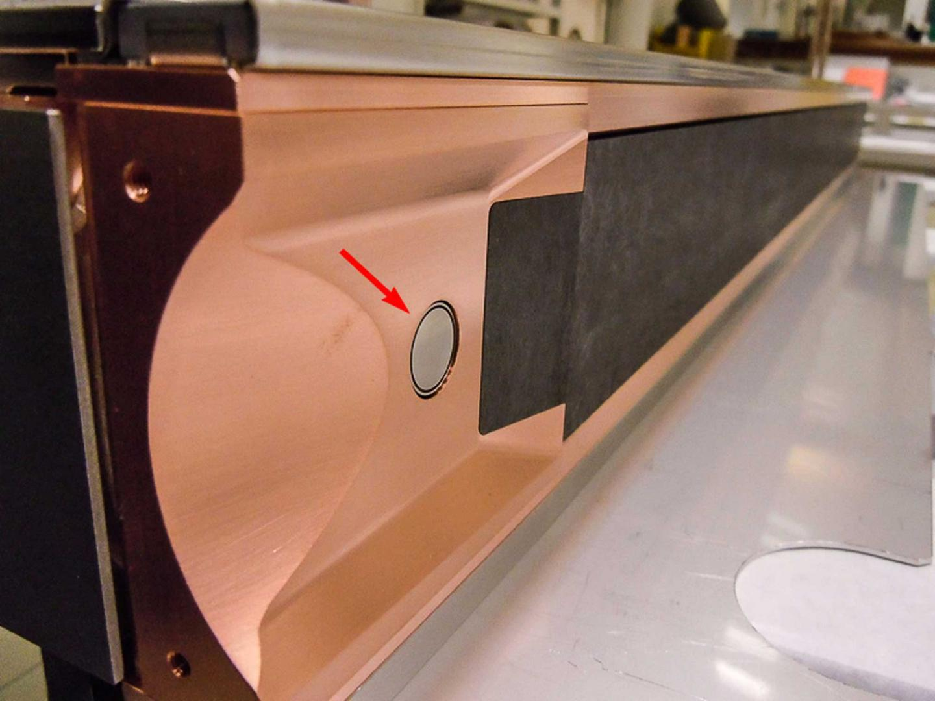
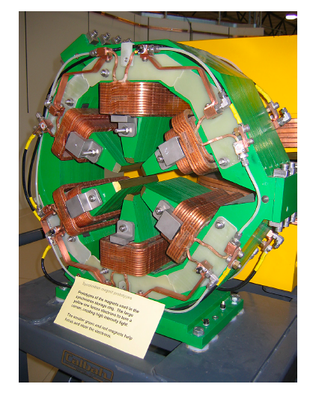
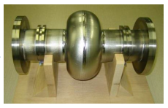
Definition of lattice elements
Each machine element or group of elements must be defined by a command.
Generic pattern to define an element
label: keyword, properties;
MAD-X keywords are used to define the type of element:
magnets, markers, RF cavities, collimators…
Examples:
Dipole magnet: MBL: SBEND, L=10.0;
Quadrupole magnet: MQ: QUADRUPOLE, L=3.3;
Sextupole magnet: MSF: SEXTUPOLE, L=1.0;
Marker: MARKER1: MARKER;

Slide 19
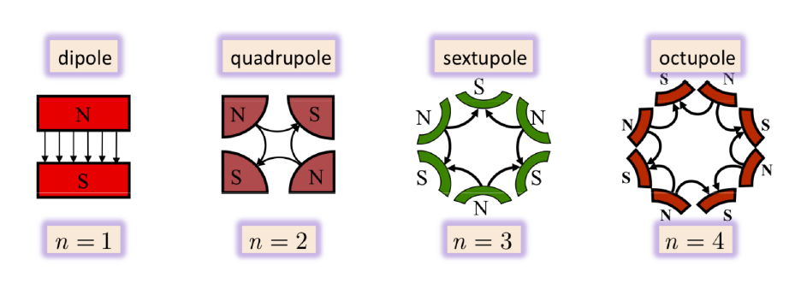

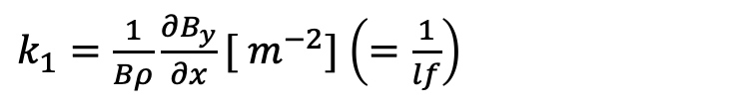
The strength of the magnets
The name of the parameter that defines the magnetic strength depends on the element:
For a dipole magnet (horizontal bending) is: angle [rad]
MBL: SBEND, ANGLE=0.05, L=10.0;
$k_{1}=\frac{1}{Bρ}\frac{∂B_{y}}{∂x}[ m^{−2}]$ $\left(=\frac{1}{lf}\right)$
For a quadrupole magnet is :
MQ: QUADRUPOLE, K1=0.00156, L=3.3;
$$k_{2}=\frac{1}{Bρ}\frac{∂^{2}B_{y}}{∂x^{2}}[m^{−3}]$$
For a sextupole magnet is:
ksf= 0.00015;
MSF: SEXTUPOLE, K2=ksf, L=1.0;
Octupoles, multiple magnet “thin” element…

Slide 20
The lattice sequence
Is an ordered collection of machine elements defining the accelerator to be studied
The position of each element in the sequence can be defined with respect to the CENTRE, EXIT or ENTRY of the element, the start of the sequence or the position of another element
Example:
#Element definition
MQ: QUADRUPOLE, L=3.3, K1=0.005;
# Sequence definition
mycell: SEQUENCE, REFER=ENTRY, L=10;
q1: MQ, at s=0;
marker1: marker, at s=2.5;
ENDSEQUENCE;

Slide 21
Basic useful MAD-X commands
Beam definition:
BEAM, PARTICLE=particle_type (proton, electron…), ENERGY=value ;
A sequence has to be activated in order to be usable for other operations with the USE command:
USE, SEQUENCE=name_sequence;
Call an external file:
CALL, FILE=name_file.madx;
Print a value in the terminal:
VALUE variable_name;
Production of graphical output (e.g. β-function)*:
PLOT, HAXIS=s, VAXIS=betx,bety, COLOUR=100, FILE=“test” ;
* Note that the data must be generated first using the advances commands such as TWISS or TRACK.

Slide 22

Questions on this first part?

Slide 23
Advances MAD-X commands
TWISS*. Optics calculations
MATCHING*. Optics optimization
TRACKING*. Beam dynamics studies
*These commands require a beam and an active sequence.

Slide 24
TWISS
The TWISS command will compute the linear lattice function (optical functions and the CO) around the machine and optionally the chromatic functions
It is a matrix code where first and second order matrices are used to get the optics
# For a periodic solution
TWISS, SEQUENCE=sequence_label, exit(by default), FILE=“test.txt”, table=TWISS (by default);
# For an initial condition (IC) solution
TWISS, SEQUENCE=sequence_label, betx=1, alfx=0, bety=1, alfy=0;
# More attributes: DELTAP, CHROM…
After a successful TWISS run, MAD-X creates a table of summary parameters named ‘SUMM’ which includes tunes, chromaticity, etc. as well as a ‘TWISS’ table and ASCII file if requested with most of the computed parameters

Slide 25
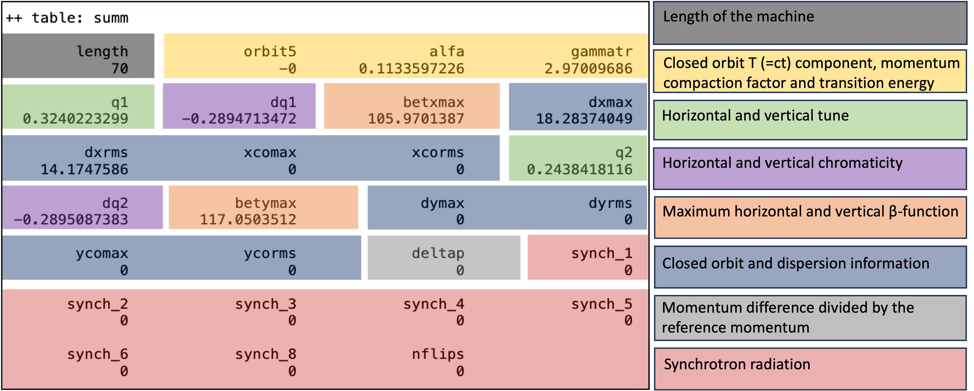
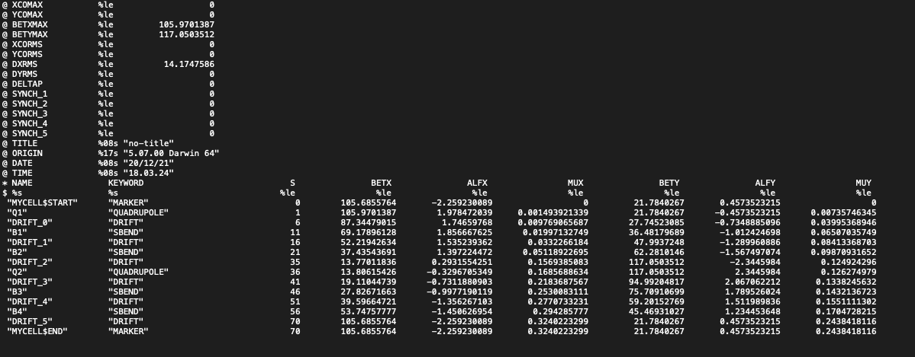
TWISS output
TWISS table
a=table(TWISS,q1,betx);
SUMM table
a=table(SUMM,dq1);
ASCII file.
With most of the parameters computed by MAD-X
SELECT, flag=TWISS, column=name, keyword, s, betx, alfx, mux, bety, alfy, muy;

Slide 26
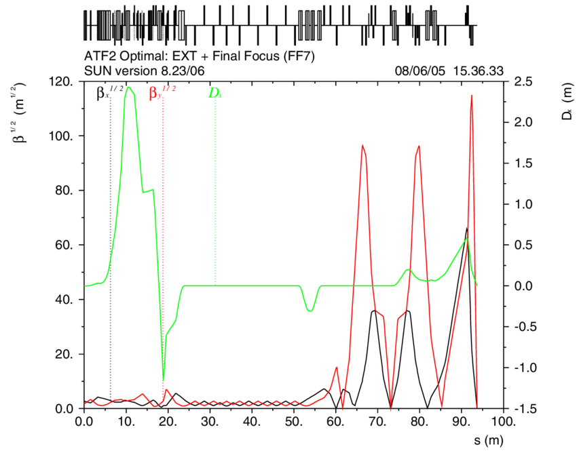
TWISS plot
Production of graphical output of the main optical functions (e.g. β-function):
PLOT, HAXIS=s, VAXIS=betx,bety, COLOUR=100, FILE=“test” ;
FODO cell example
Transfer line example

Slide 27
Global matching
It is possible to modify the optical parameters of a lattice using the MATCHING module.
Adjusting the magnetic strengths to get the desired global properties.
Examples for global parameters: Q1 and Q2 (horizontal and vertical tunes) and dQ1 and dQ2 (horizontal and vertical chromaticity)
Example
MATCH, SEQUENCE=sequence_name;
GLOBAL, Q1=26.58; H-tune
GLOBAL, Q2=26.62; V-tune
VARY, NAME=kqf, STEP=0.00001;
VARY, NAME=kqd, STEP=0.00001;
LMDIF, CALLS=50, TOLERANCE=1e-6;
ENDMATCH;
Methods for the minimization.
LMDIF accepts two attributes:
CALLS, maximum number of calls to the penalty function;
TOLERANCES, the desired tolerance for the minimum.
http://mad.web.cern.ch/mad/releases/5.02.08/madxuguide.pdf
What we want!
What we change!

Slide 28
Other types of matching
Local matching and performance matching:
Local optical functions (insertions, local optics changes)
Any user defined variable
Instead of GLOBAL command we use CONSTRAINT!
Example:
MATCH, SEQUENCE=sequence_name;
CONSTRAIN, range=#s/#e, BETX=50;
CONSTRAIN, range=#s/#e, ALFX=-2;
VARY, NAME=kqf, STEP=0.00001;
VARY, NAME=kqd, STEP=0.00001;
LMDIF, CALLS=50, TOLERANCE=1e-6;
ENDMATCH;
What we want!
What we change!

Slide 29
Tracking
The TRACK module allows us to perform single particle tracking for given initial conditions
It is based on building transfer maps by solving the Hamiltonian equations of each element
Example
SELECT, FLAG=makethin, SLICE=1;
MAKETHIN, SEQUENCE=seq_name;
TRACK, dump, file=“name”, DELTAP=0.01;
START, x=1e-3, px=0, y=1e-3, py=0;
START, x=1e-2, px=0, y=1e-3, py=0;
run, turns=100;
Convert the thick lattice to a thin lens one!
Off-momentum!
Particles initial conditions!
Number of turns!
Output: ‘TRACK’ table, file.txt
Plot:
PLOT, file="track1",table=track, haxis=x, vaxis=px, colour=100;

Slide 30
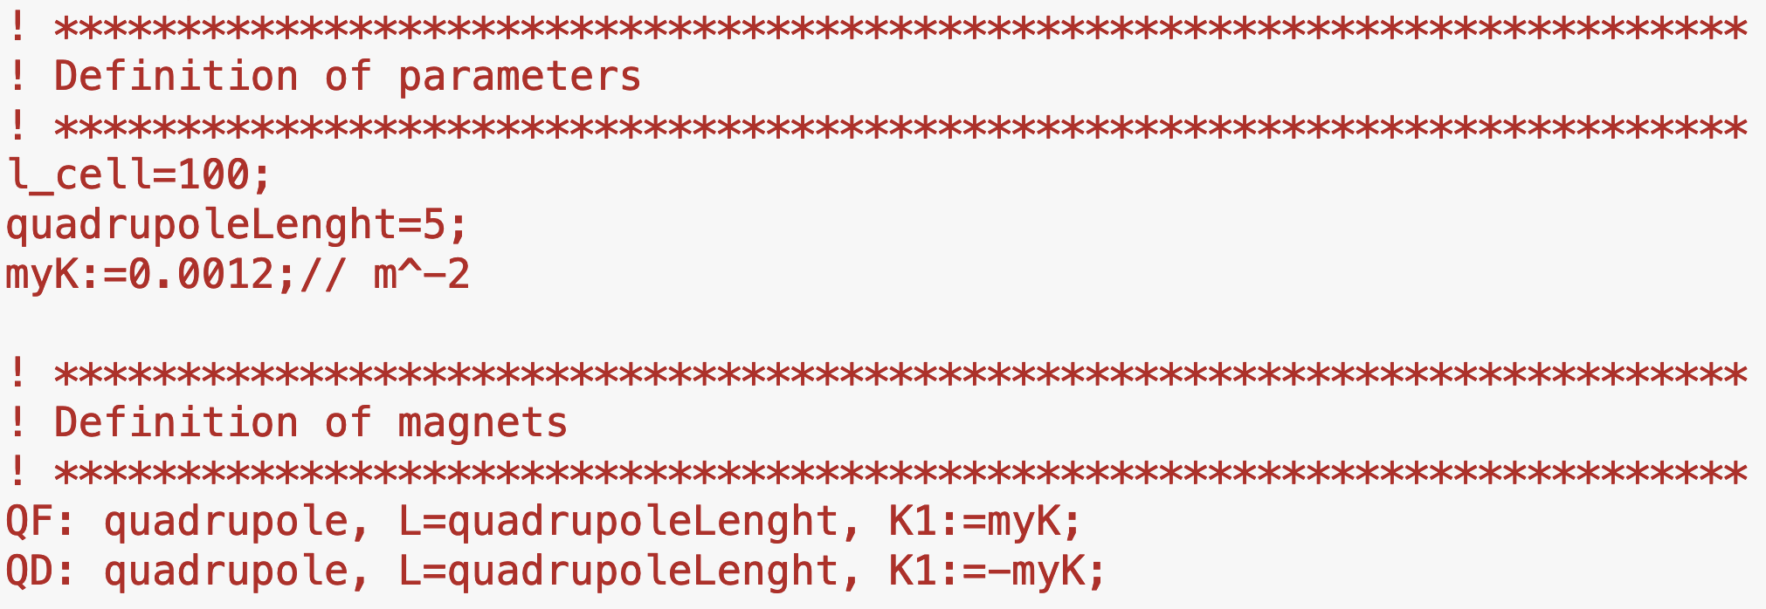
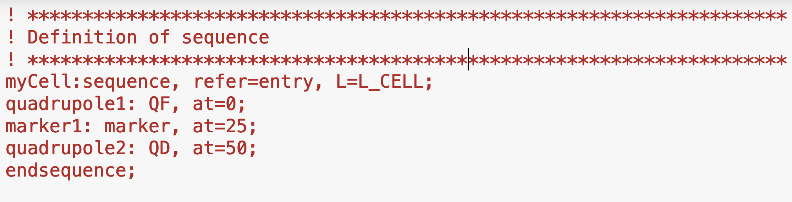
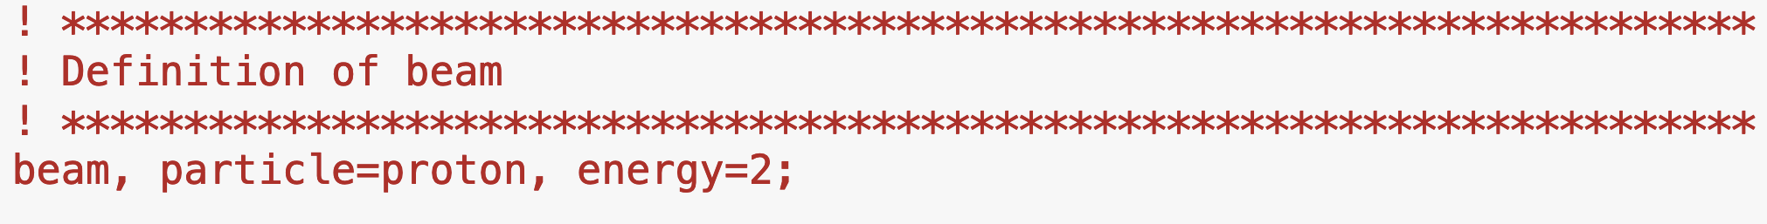
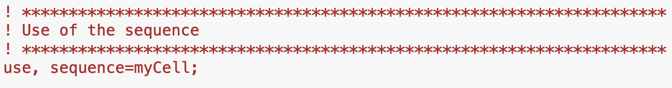
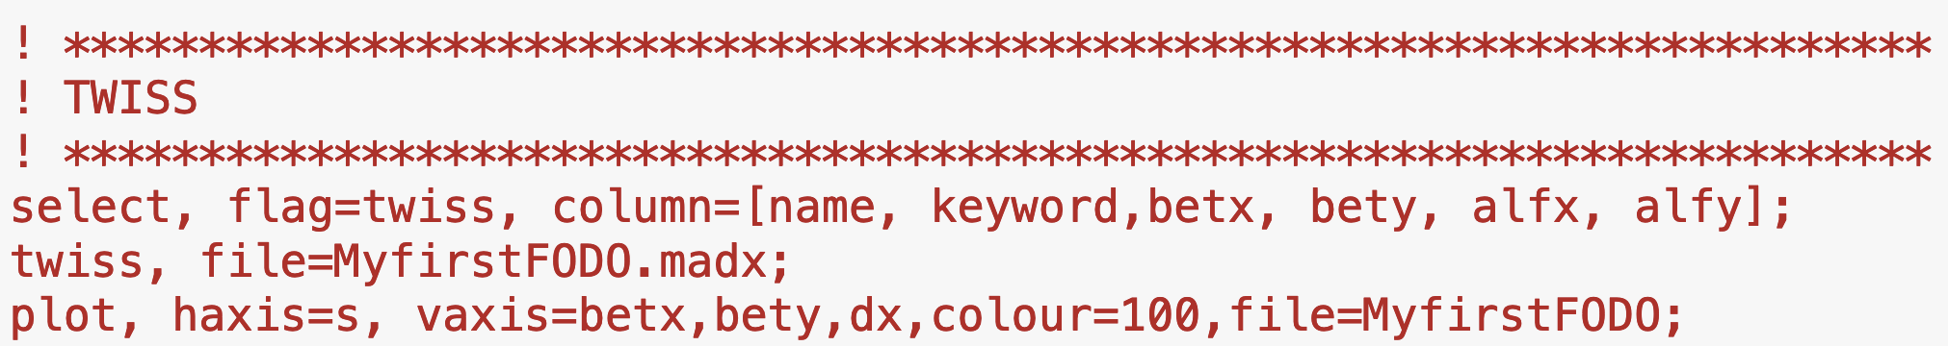
Example case
What is the machine in question?
L_{d}
L_{q}
FQ
DQ
L_{cell}
What will be running in the machine?
What do you want to study about the machine?
Notes:
With the ingredients we have defined so far we can write a basic input file for optics calculations with MAD-X.

Slide 31
How to run MAD-X
Interactive mode
Batch mode
Python interface

Slide 32
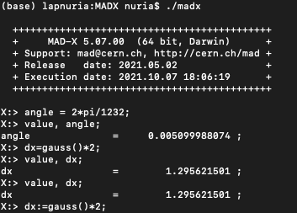
How to run MAD-X: interactive mode
You download the last release from the repository and follow the instruction in: http://madx.web.cern.ch/madx/
In Windows, run the executable.
In Linux (OXS), execute ./madx in the containing directory.
Usually not optimum…

Slide 33
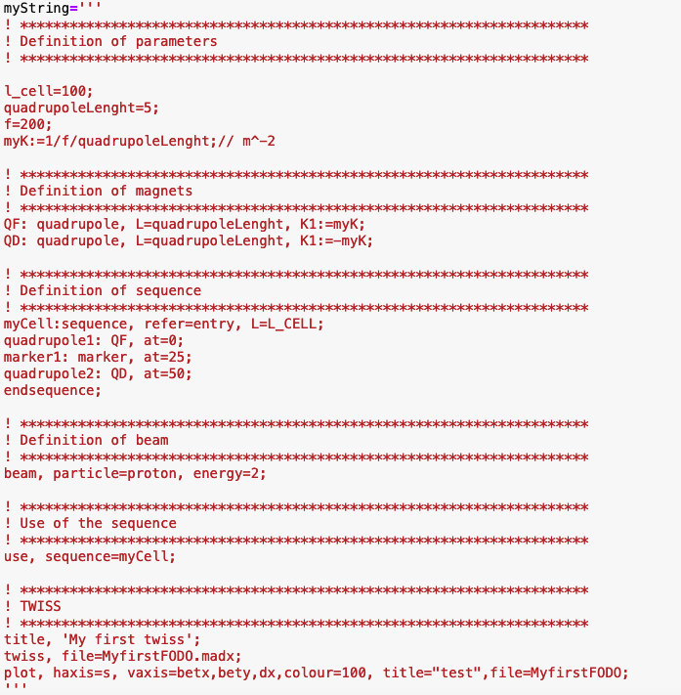
How to run MAD-X: batch mode
myfile.madx
After writing your script in a separate file myfile.madx, you can call it in Windows after opening MAD-X:
madx
X: ==> call, file=myfile.madx;
In Linux, you can also type in the terminal:
./madx myfile.madx

Slide 34


How to run MAD-X: python interface I
During the workshop we will use MAD-X trough a python jupyter interface based on the python scripting language
Why?
MAD-X has no graphical interface and for detailed processing of MAD-X results, other programming languages are often used
Python is widely used in the physics community and provides powerful numerical and plotting libraries
Jupyter is web application that allows to create and share live code

Slide 35
How to run MAD-X: python interface II
Load
Jupyter notebook
Cpymad library*
Run
Communicate (send MAD-X commands and read output data)
MAD-X process
*It is a binding to MAD-X for giving full control and access to a MAD-X interpreter in python http://hibtc.github.io/cpymad/getting-started

Slide 36
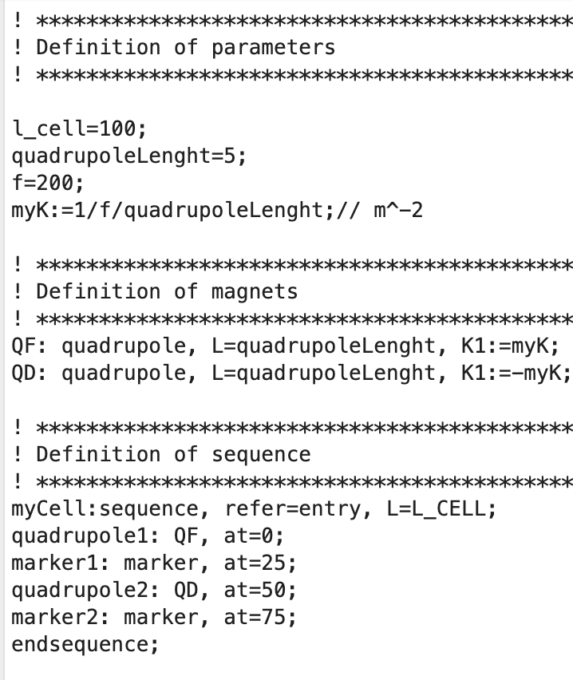
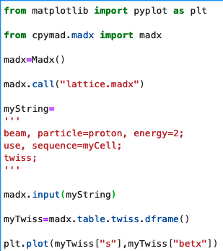
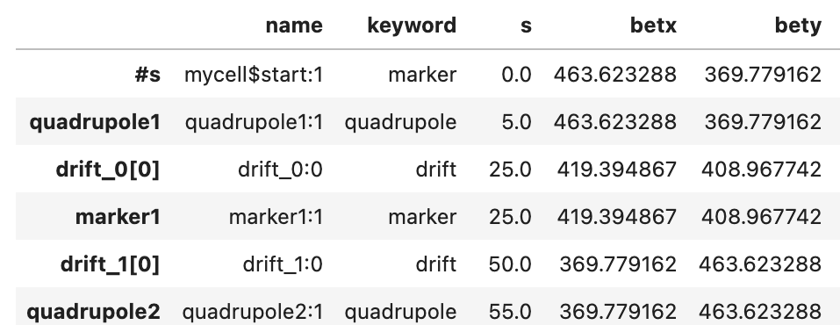
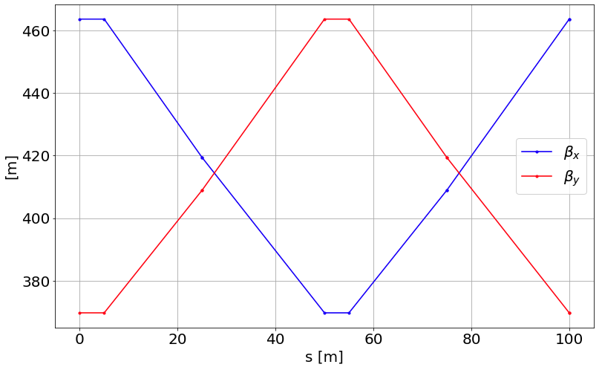
How to run MAD-X: python interface III
jupyter-notebook
Load cpymad library*
lattice.madx
(ASCII file)
Run a MAD-X process
Define lattice input file
Use of cpymad.madx methods (call, input, table.twiss.dframe, table.sum.dframe)
MAD-X commands
Data analysis (plots…)

Slide 37
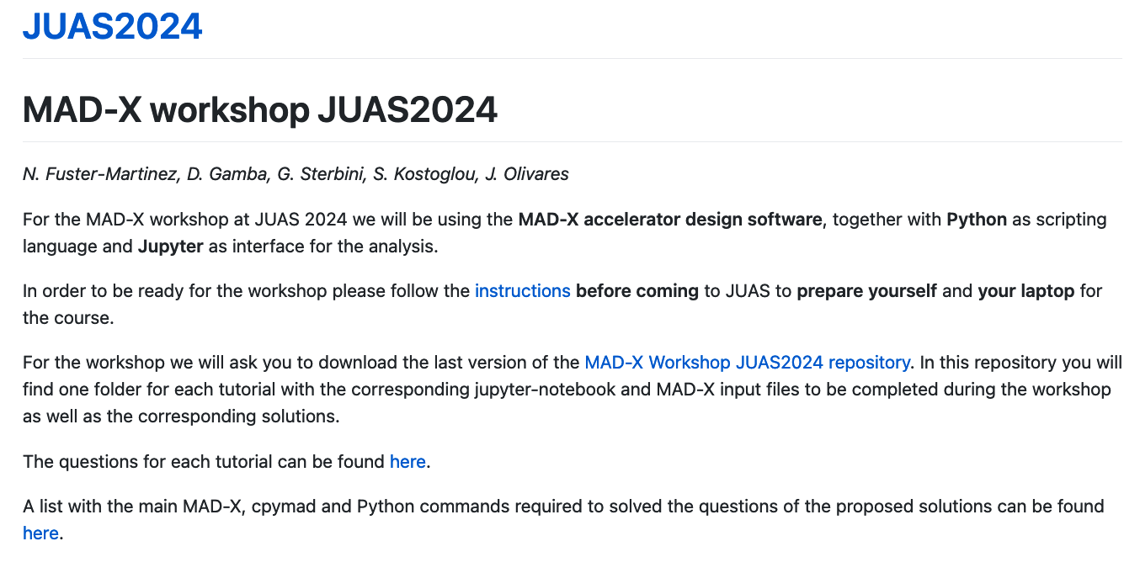
How to run MAD-X: python interface IV
We provided you with the instructions to set-up the working environment: https://fusterma.github.io/JUAS2024/
Once the environment is set-up you can download the last version of the “MAD-X Workshop JUAS2024 repository” and open a JupyterLab interface and start working on the tutorials!

Slide 38
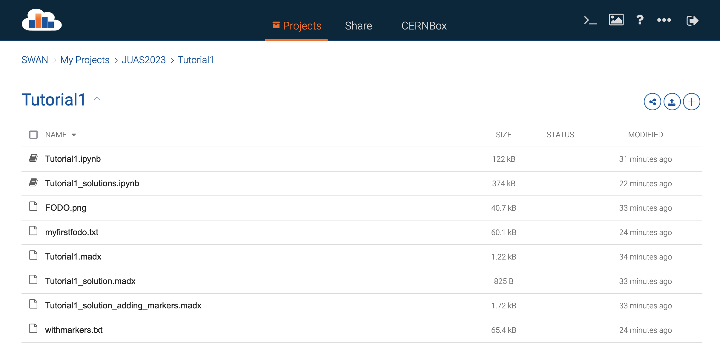
How to run MAD-X: python interface V
If you had problems with the environment set-up:
You can work using the SWAN CERN service using the CERN computing account
SWAN CERN service:
https://swan.cern.ch
Log-in with your credentials
Create a new project, “JUAS 2024”
Load the folders and files in the “MAD-X Workshop JUAS2024 repository” into the new project.
Open the first tutorial jupyter-notebook “Tutorial1.ipynb”

Slide 39

Thank you very much for your attention!
Questions?
Let’s finish with a quick quiz!

